Slide 1

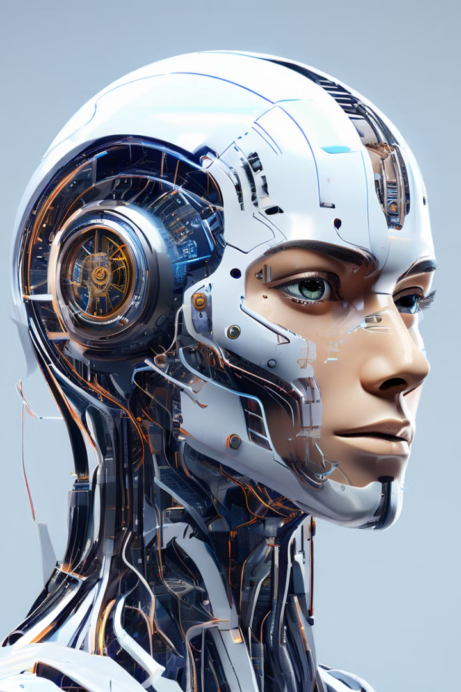

Artificial Intelligence
Artificial Intelligence (AI) and Machine Learning (ML) are rapidly transforming the way we live and work. These powerful technologies are enabling computers to learn from data, make predictions, and automate tasks in ways that were once unimaginable.
Notes:
1

Slide 2
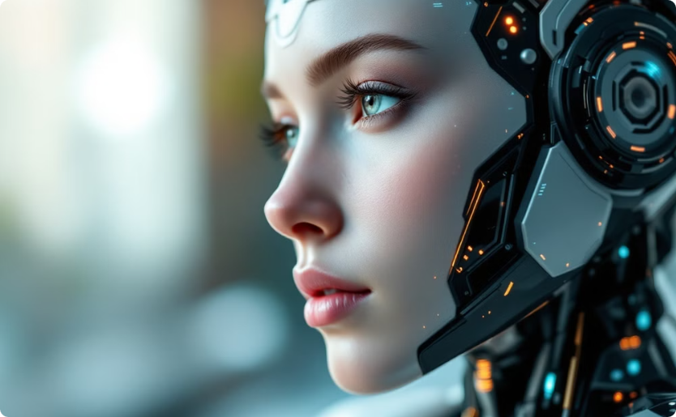
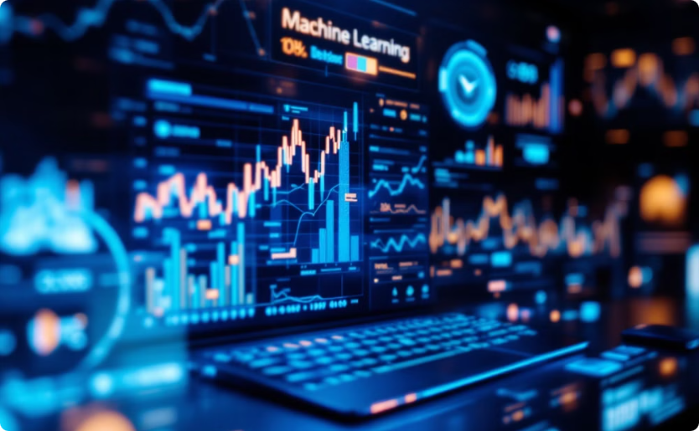
Artificial Intelligence (AI)
Machine Learning (ML)
Machines carrying out tasks in a way we consider "intelligent".
Systems learning and improving from experience without explicit programming.
Notes:
2

Slide 3



How AI and ML are used in everyday life…
Product Recommendations
Fraud Detection
Personal Assistants
Online retailers use ML algorithms to study your shopping habits and recommend products you're likely to enjoy.
Banks and financial institutions use AI to instantly spot fraudulent transactions, protecting your money from theft.
AI-powered virtual assistants like Siri, Alexa, and Google Assistant can understand your requests and complete tasks, making your life easier.
Notes:
3

Slide 4
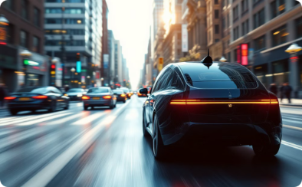

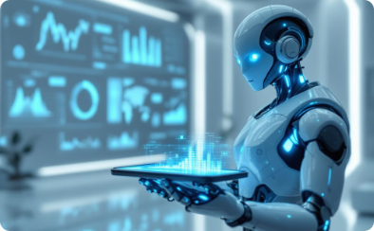
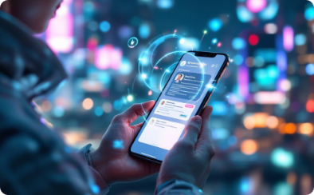
More AI and ML Examples..!
Self-Driving Cars
Medical Diagnoses
Predictive Analytics
Personalized Experiences
AI and ML power autonomous vehicles to perceive their environment, make decisions, and navigate without human intervention.
ML algorithms can analyze medical images and data to assist doctors in making more accurate and timely diagnoses.
AI and ML identify patterns in data to make predictions about future events, trends, and behaviors.
AI-powered systems tailor content, recommendations, and interactions to each user's preferences and needs.
Notes:
4

Slide 5
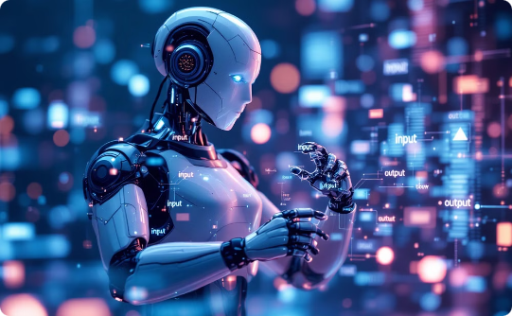
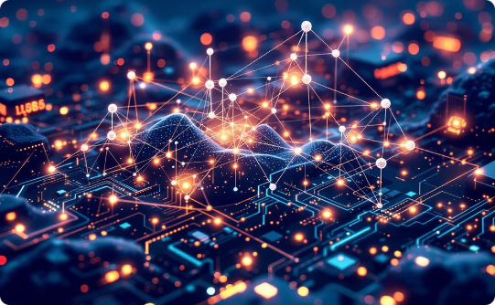
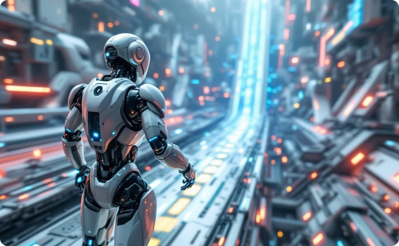
Types of Learning in ML
Supervised Learning
Unsupervised Learning
Reinforcement Learning
The algorithm learns to map inputs to outputs by being trained on a labeled dataset.
The algorithm discovers patterns and relationships in unlabeled data without any specific goal or target.
The algorithm learns by taking actions in an environment and receiving rewards or penalties to maximize a specific outcome.
Notes:
5

Slide 6
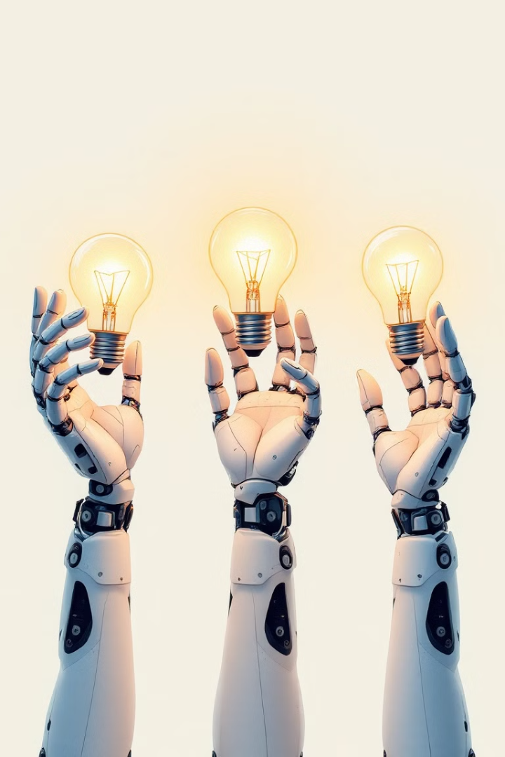
Key Differences
Supervised Learning
Unsupervised Learning
Reinforcement Learning
Requires labeled training data. Focuses on predicting known outcomes.
Discovers hidden patterns in unlabeled data. Identifies intrinsic structures and relationships.
Learns by trial-and-error interactions with an environment. Maximizes a reward signal.
Notes:
6

Slide 7
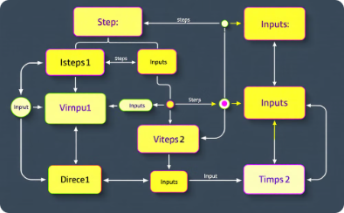
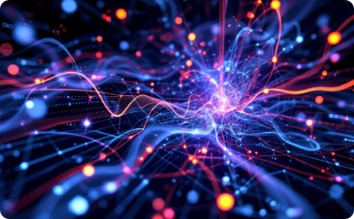
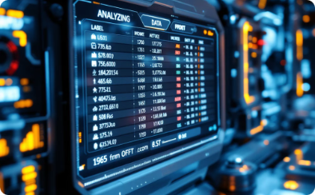

Key Concepts and Terminologies
Algorithms
Model
Training Data
Testing Data
Step-by-step procedures for calculations and decision-making processes.
Mathematical representation of real world processes used in predicting outcomes.
The dataset utilized to teach and adjust the model's parameters during the learning phase.
Data employed to assess the model's performance and generalization capability on new, unseen data.
Notes:
7

Slide 8
Machine Learning Process in 6 steps...
Notes:
9

Slide 9
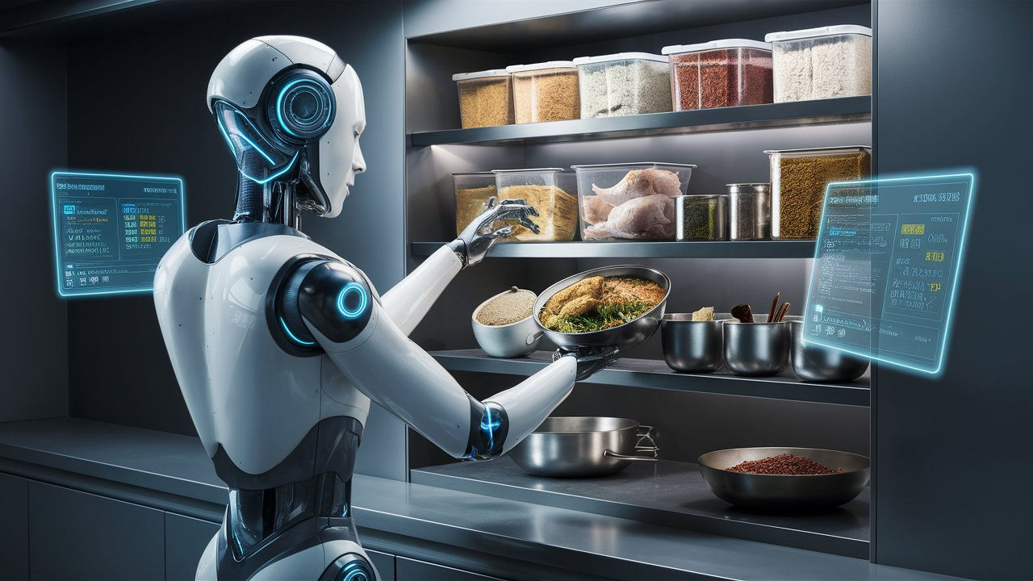
Data Collection

Slide 10
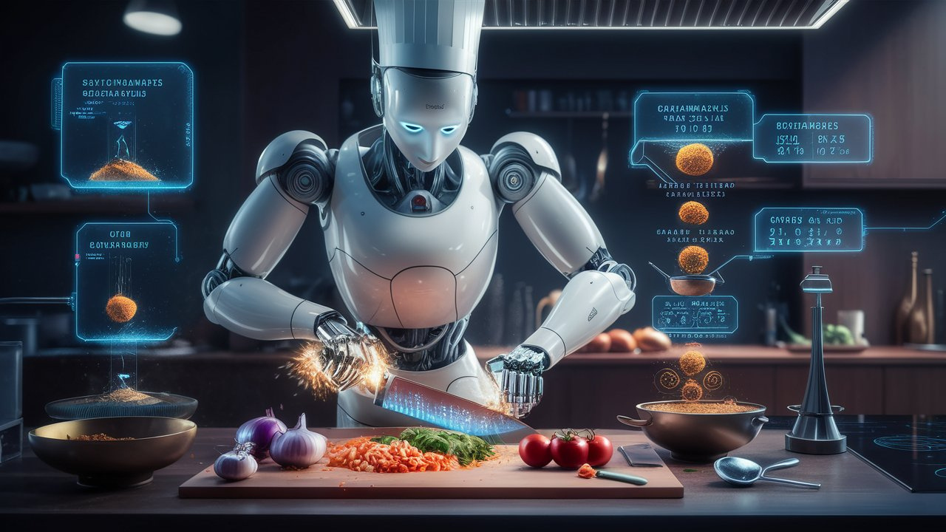
Data Preprocessing

Slide 11
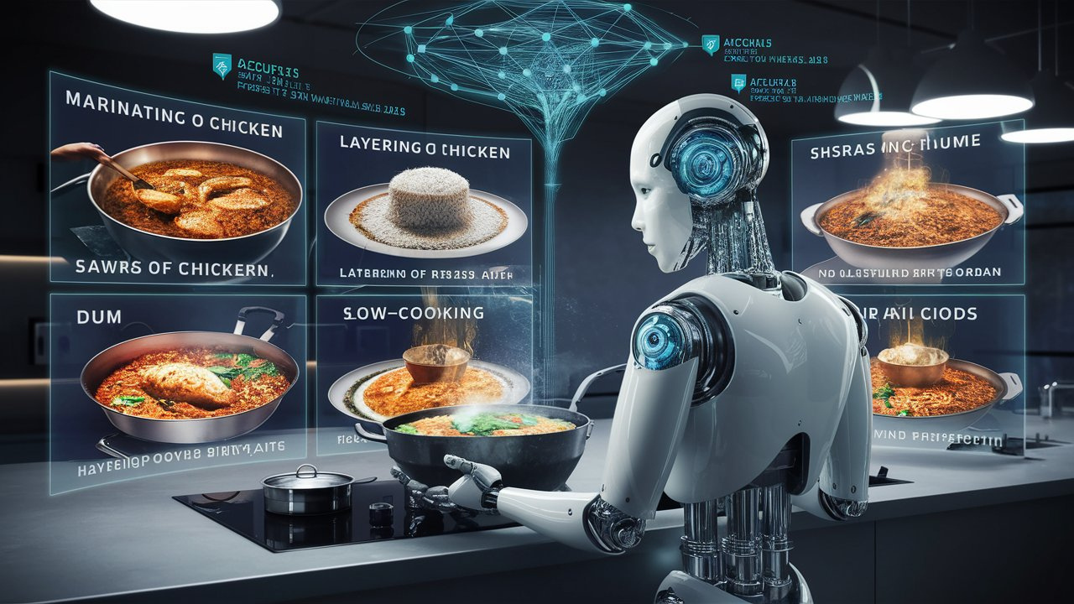
Model Training

Slide 12
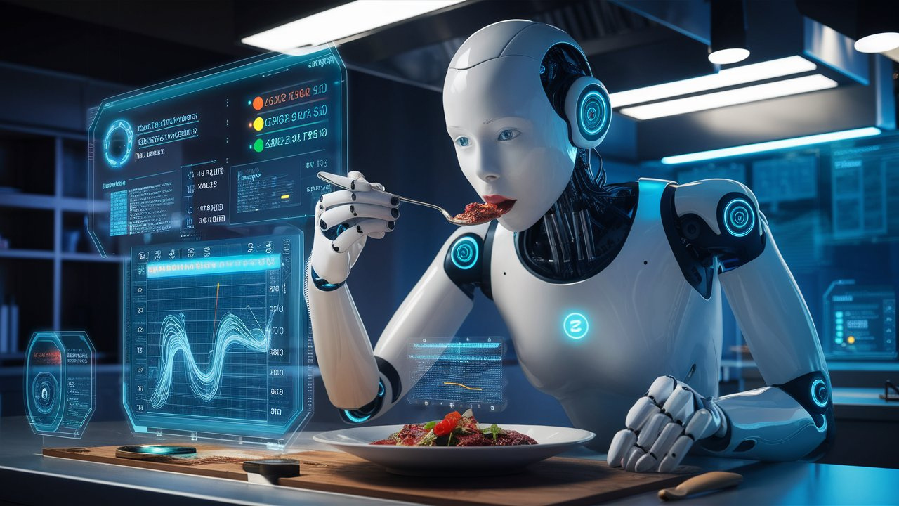
Model Evaluation

Slide 13
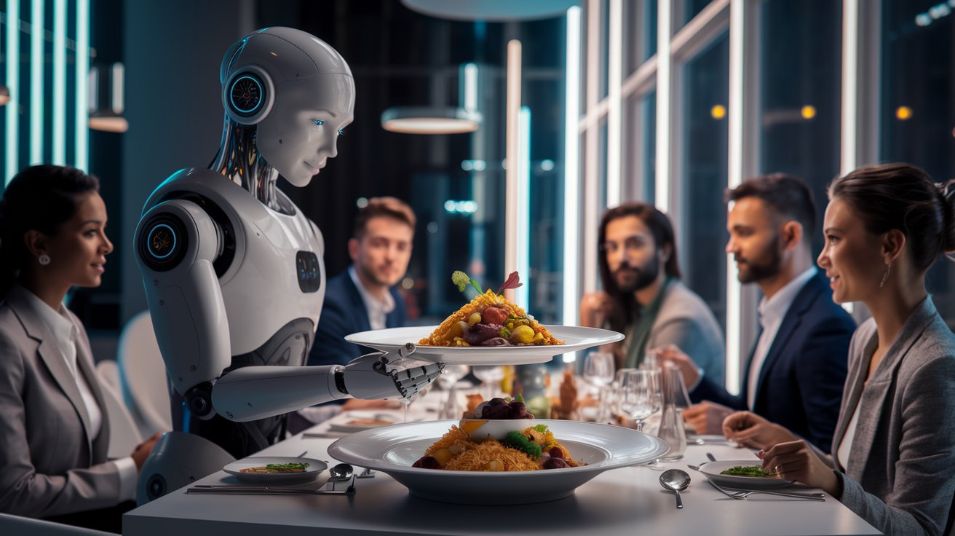
Deployment

Slide 14
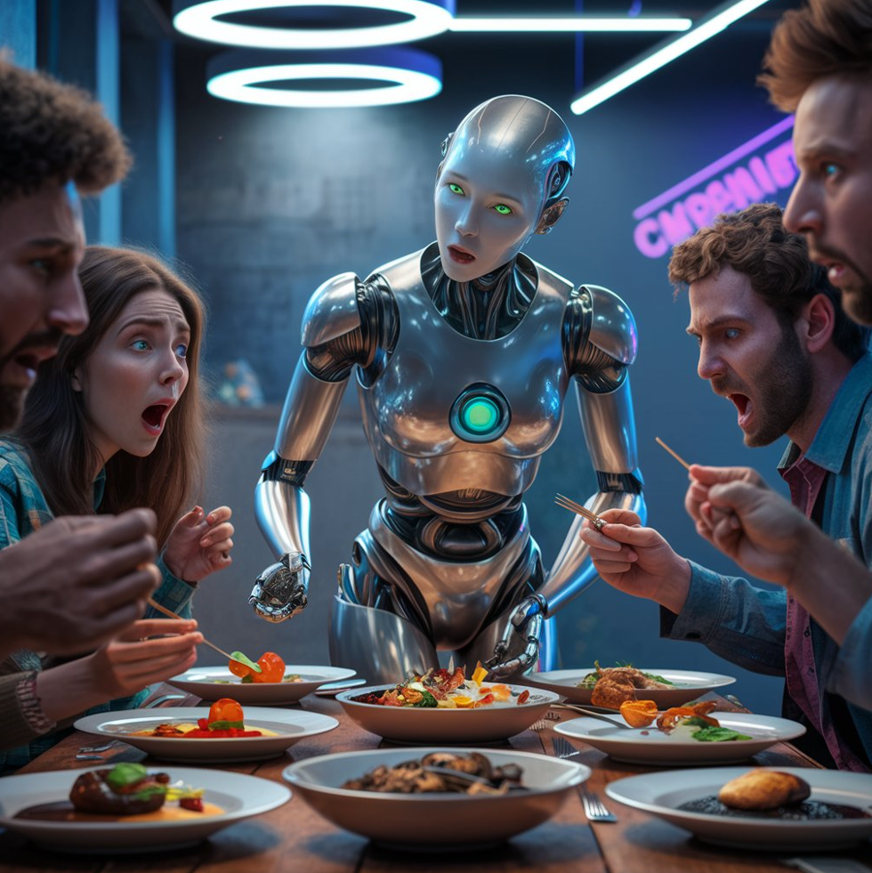
Monitoring

Slide 15
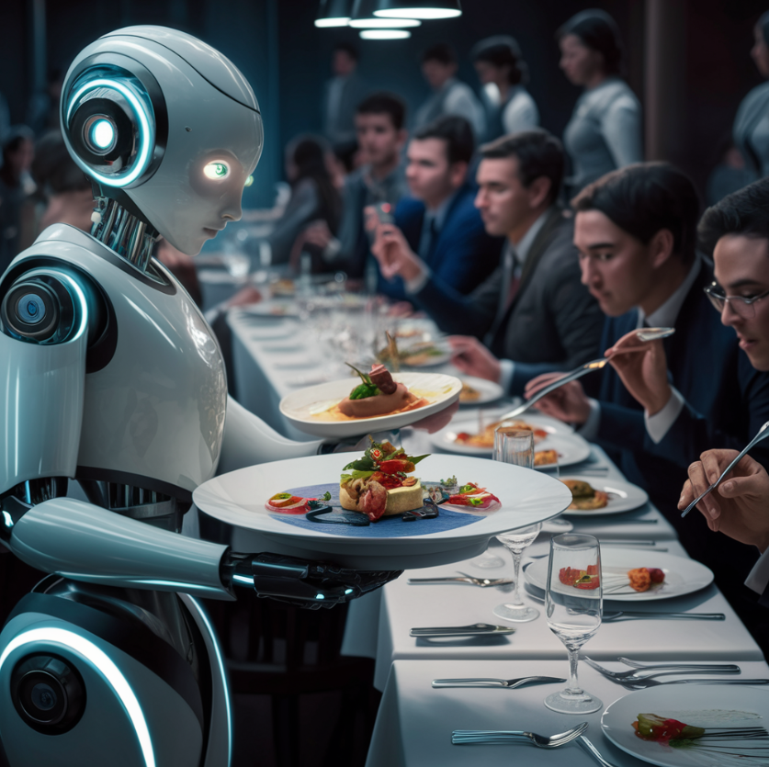
Machine Learning Process
Key Steps in the Machine Learning Journey
1
Data Collection
Gather Relevant data from various sources like databases or APIs
2
Data Preparation
Clean and organize data to ensure quality and consistency
3
Model Training
Utilize algorithms to enable the model to learn patterns from data.
4
Model Evaluation
Assets the model's accuracy and performance using metrics.
5
Deployment
Implement the trained model in real-world applications for use.
6
Monitoring
Continuously track and improve the model's performance over time.
Notes:
8

Slide 16
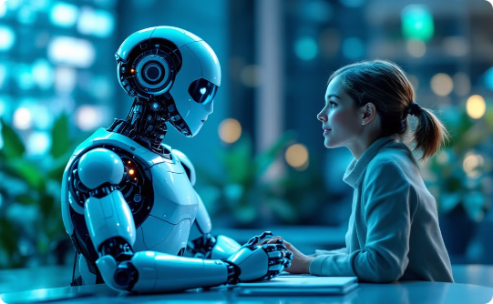

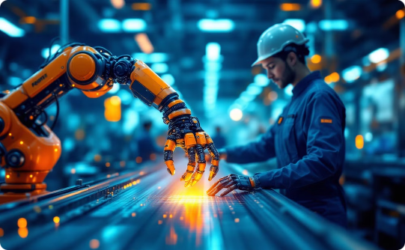
Common Applications of AI/ML
Natural Language Processing
Computer Vision
Robotics
Enables machines to understand, interpret, and generate human language.
Allows machines to identify and process digital images and videos.
Combines AI and ML to create intelligent, autonomous, and adaptable robots.
Notes:
10

Slide 17
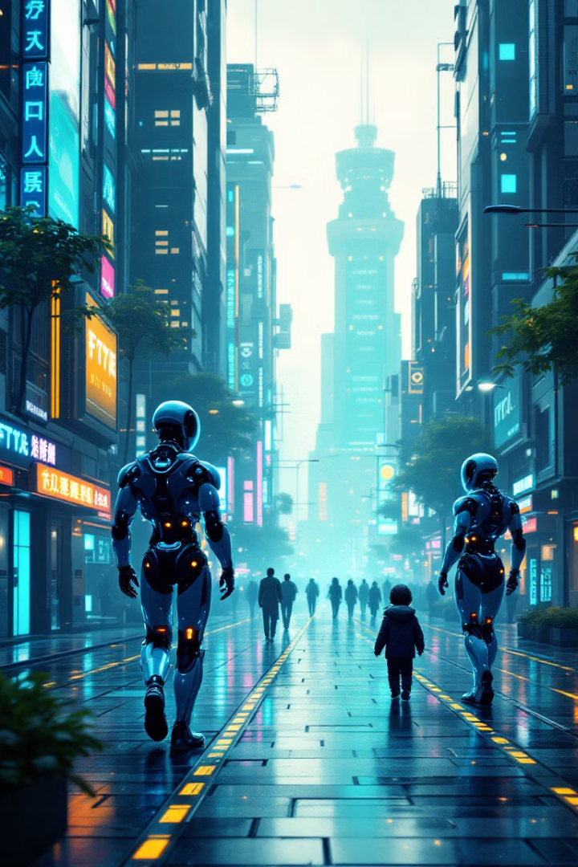



The Future of AI and ML
Increasing Capabilities
AI and ML will continue to expand their ability to solve complex problems and automate a wide range of tasks.
Ethical Considerations
As AI becomes more advanced, there will be growing concerns about privacy, bias, and the responsible use of these technologies.
Human-AI Collaboration
AI will increasingly work alongside humans, augmenting our intelligence and capabilities rather than replacing us entirely.
Notes:
11

Slide 18
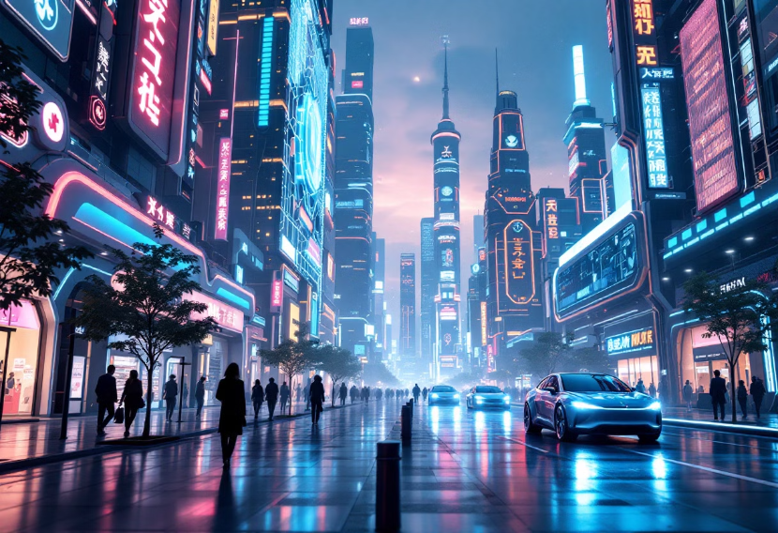
Brainstorm: AI and ML in the Real World
Healthcare
Education
Finance
E-commerce
Entertainment
Transportation
Notes:
12

